Slide 1
CLOUD RESOURCES: THE BASICS

Slide 2
What is a “Cloud Resource”
The Core Idea: A cloud resource is a fundamental, on-demand IT asset—like computing power, storage, or networking—that you access over the internet.
A Simple Analogy: Think of it like a public utility. You don't build your own power plant; you simply connect to the grid and pay for the electricity you use. In the same way, you don't buy and manage your own physical servers; you connect to a cloud provider's network and use the resources you need, when you need them.
Key Characteristics:
On-Demand: You can get these resources instantly, without human intervention.
Pay-as-you-go: You only pay for what you use, turning a large upfront cost into a simple operating expense.
Elastic: You can easily scale up or down to meet demand, paying for peak usage only when it's needed.

Slide 3
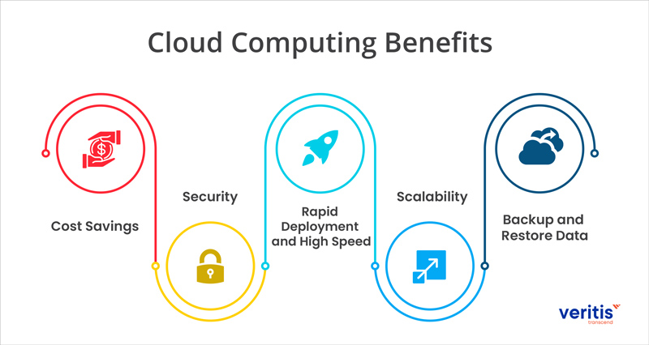
The "Why": Driving Cloud Adoption

Slide 4
Three Pillars
The Pillars:
Compute: The processing power and memory. It’s the "brain" of your cloud presence.
Storage: The persistent space where you save your data and files. It's the "memory" of the cloud.
Networking: The infrastructure that connects your resources, allowing them to communicate with each other and with the rest of the internet. It's the "nervous system."

Slide 5
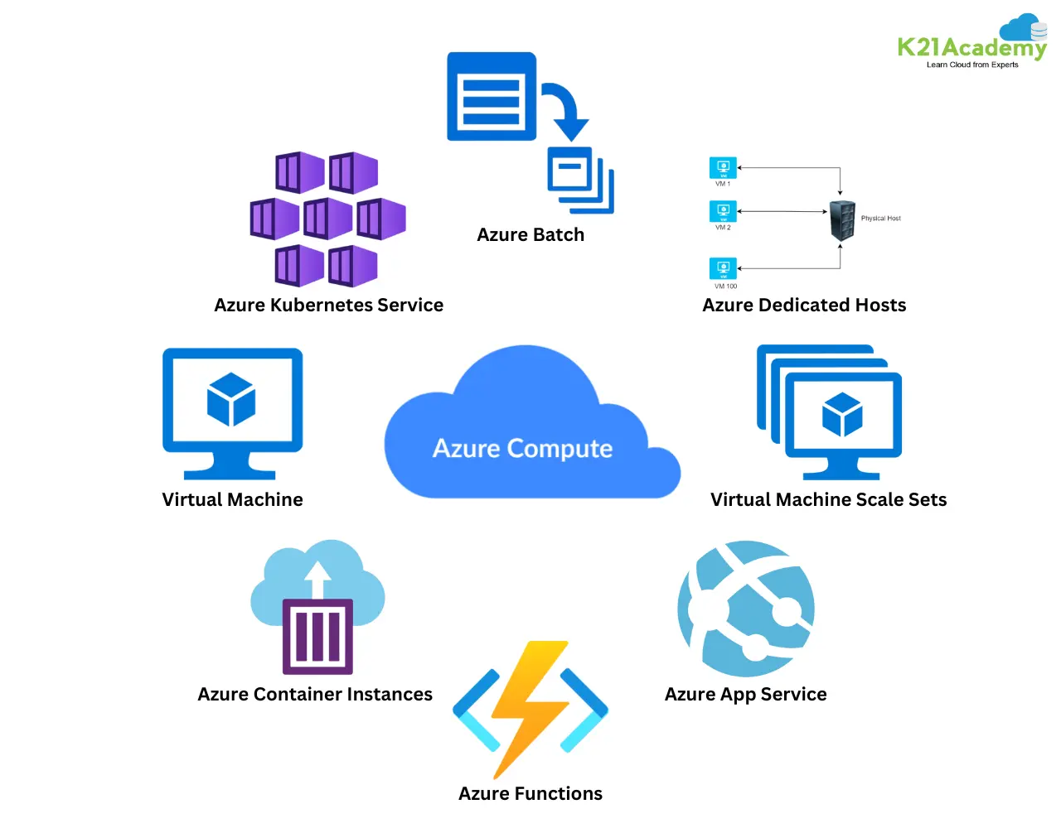
Compute: The Engine of the Cloud
What it is:
Provides the CPU and RAM necessary to run your applications, services, and workloads.

Slide 6
Storage: The Data Repository
What it is:
Provides various ways to persistently store and retrieve your digital information.
Common Resources:
Object Storage: A highly scalable, durable, and cost-effective way to store any type of unstructured data (files, images, videos, backups). Data is organized as objects with unique identifiers, not in a traditional folder structure.
Managed Databases: A fully managed service for structured data. The provider handles the maintenance, backups, and scaling, so you can focus on building your application. Used for applications that require structured data, like e-commerce or user profiles.

Slide 7
Networking: The Connectivity Fabric
What it is:
The virtual network infrastructure that connects your cloud resources and manages traffic to and from the internet.
Common Resources:
Virtual Private Cloud (VPC): A logically isolated, private network segment within the cloud where you can launch your resources. It gives you control over your IP address ranges and network security.
Content Delivery Network (CDN): A globally distributed network of servers that caches your website content (e.g., images, videos) closer to your users. This speeds up delivery and reduces latency.

Slide 8
The Shared Responsibility Model
The Model:
Cloud Provider's Responsibility:
The provider is responsible for security of the cloud (the physical data centers, the hardware, and the underlying services).
Your Responsibility:
You are responsible for security in the cloud (securing your data, managing user access, and configuring your resources correctly).

Slide 9
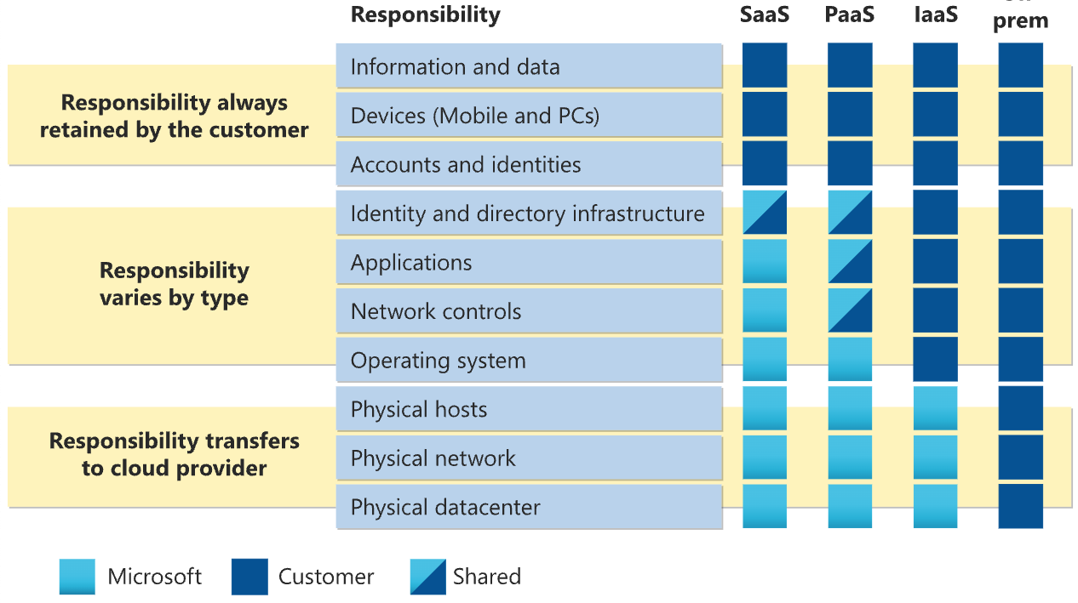
Visual Shared Responsibility Model

Slide 10
Real-World Example: Let’s Build it!
The Components:
Compute: Virtual Machine
Storage: Azure Files refers to the overall service that provides fully managed file shares in the cloud. Think of as "file share drives" or network drives that you can mount and access from your cloud or on-premises deployments.
Networking: A VPC to create a secure, private network.

Slide 11
Questions?
Artificial Intelligence
Integration Center

